Slide 1
Windows File Permissions and Group Properties
Anika Karpurapu

Slide 2
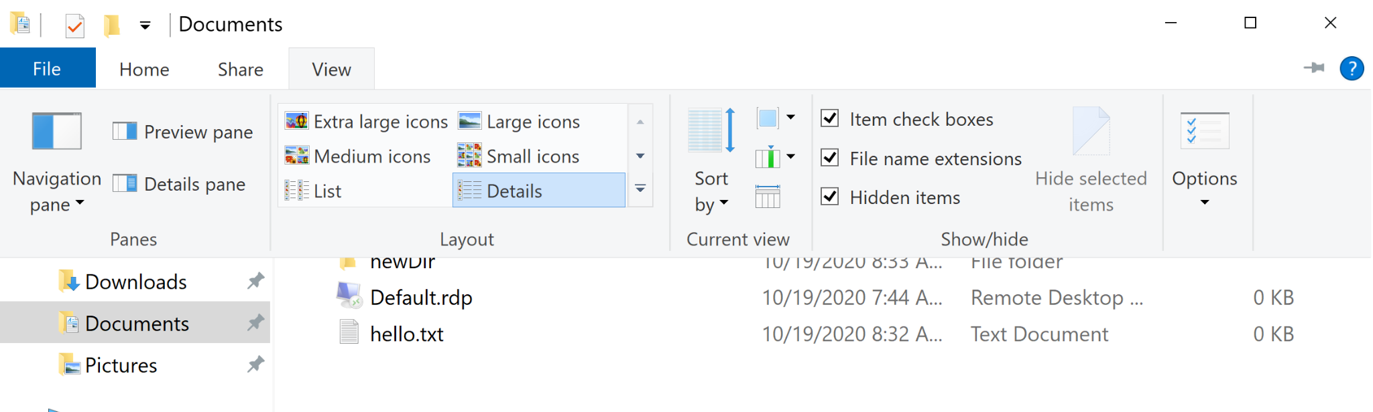
Finding Files
File explorer → View → Check the boxes under show/hide → Search Bar

Slide 3
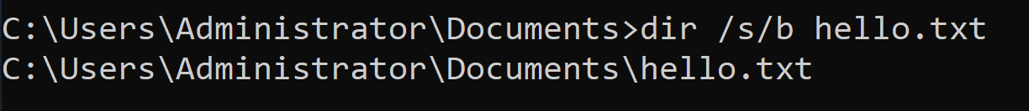
Finding Files
Command Prompt:
dir /s/b [file]
[file] is either the file name or *.[file extension]
Can redirect all outputs to a file by adding “> [filename]”

Slide 4
Recovering Lost Files
Non-permanent deletions:
Ctrl+Z
Check the recycle bin
A couple of options for permanent deletions:
Turn on “file history” and click the “restore” button on a folder
Windows File Recovery
Microsoft creates a recovery folder titled Recovery_<date and time> at the destination you specify
Without third-party software
Replace “X” with your hard drive letter
"chkdsk X: /f" "ATTRIB -H -R -S /S /D X:*.*"
Takes a little while to run
Recovery Backup
Restores files from a previous version (backup)

Slide 5
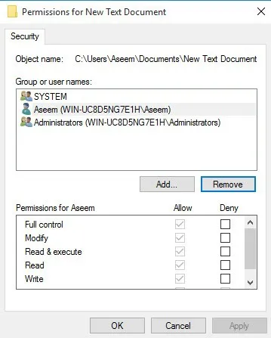
File Permissions
Files get permissions from their parent folder
At least three basic permissions:
SYSTEM
Current user (account that’s logged in)
Administrators
Greyed permission = inherited

Slide 6
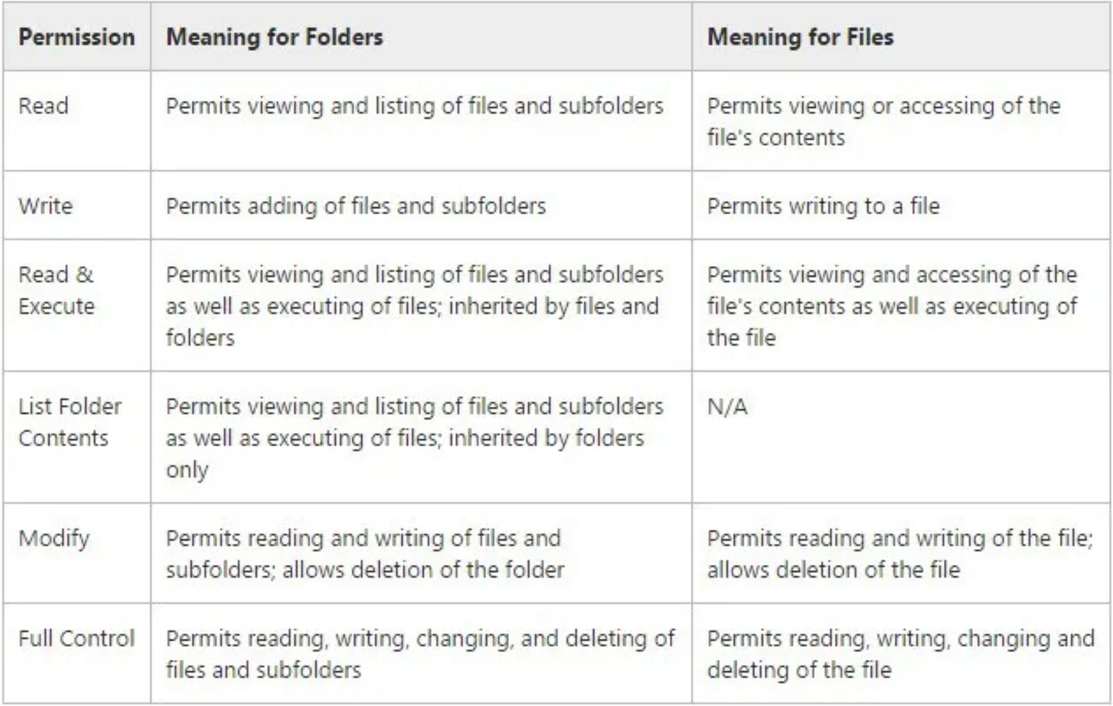
Permission Types

Slide 7
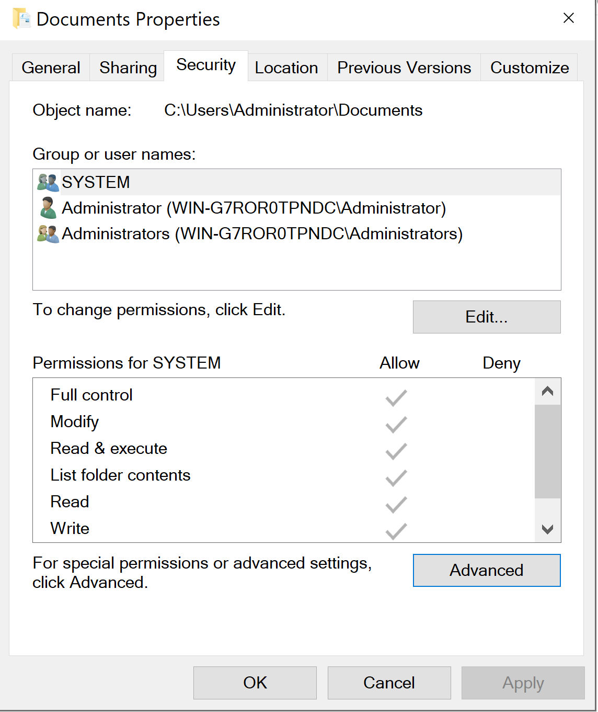
Accessing Permissions
Right click on a file or folder → Properties → Security

Slide 8
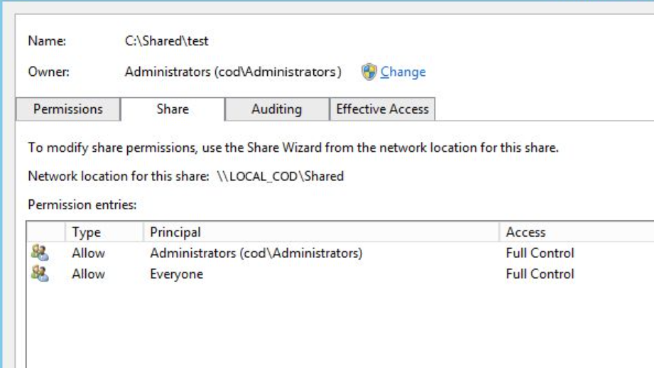
File Permissions
“Share” tab to see all the permissions

Slide 9
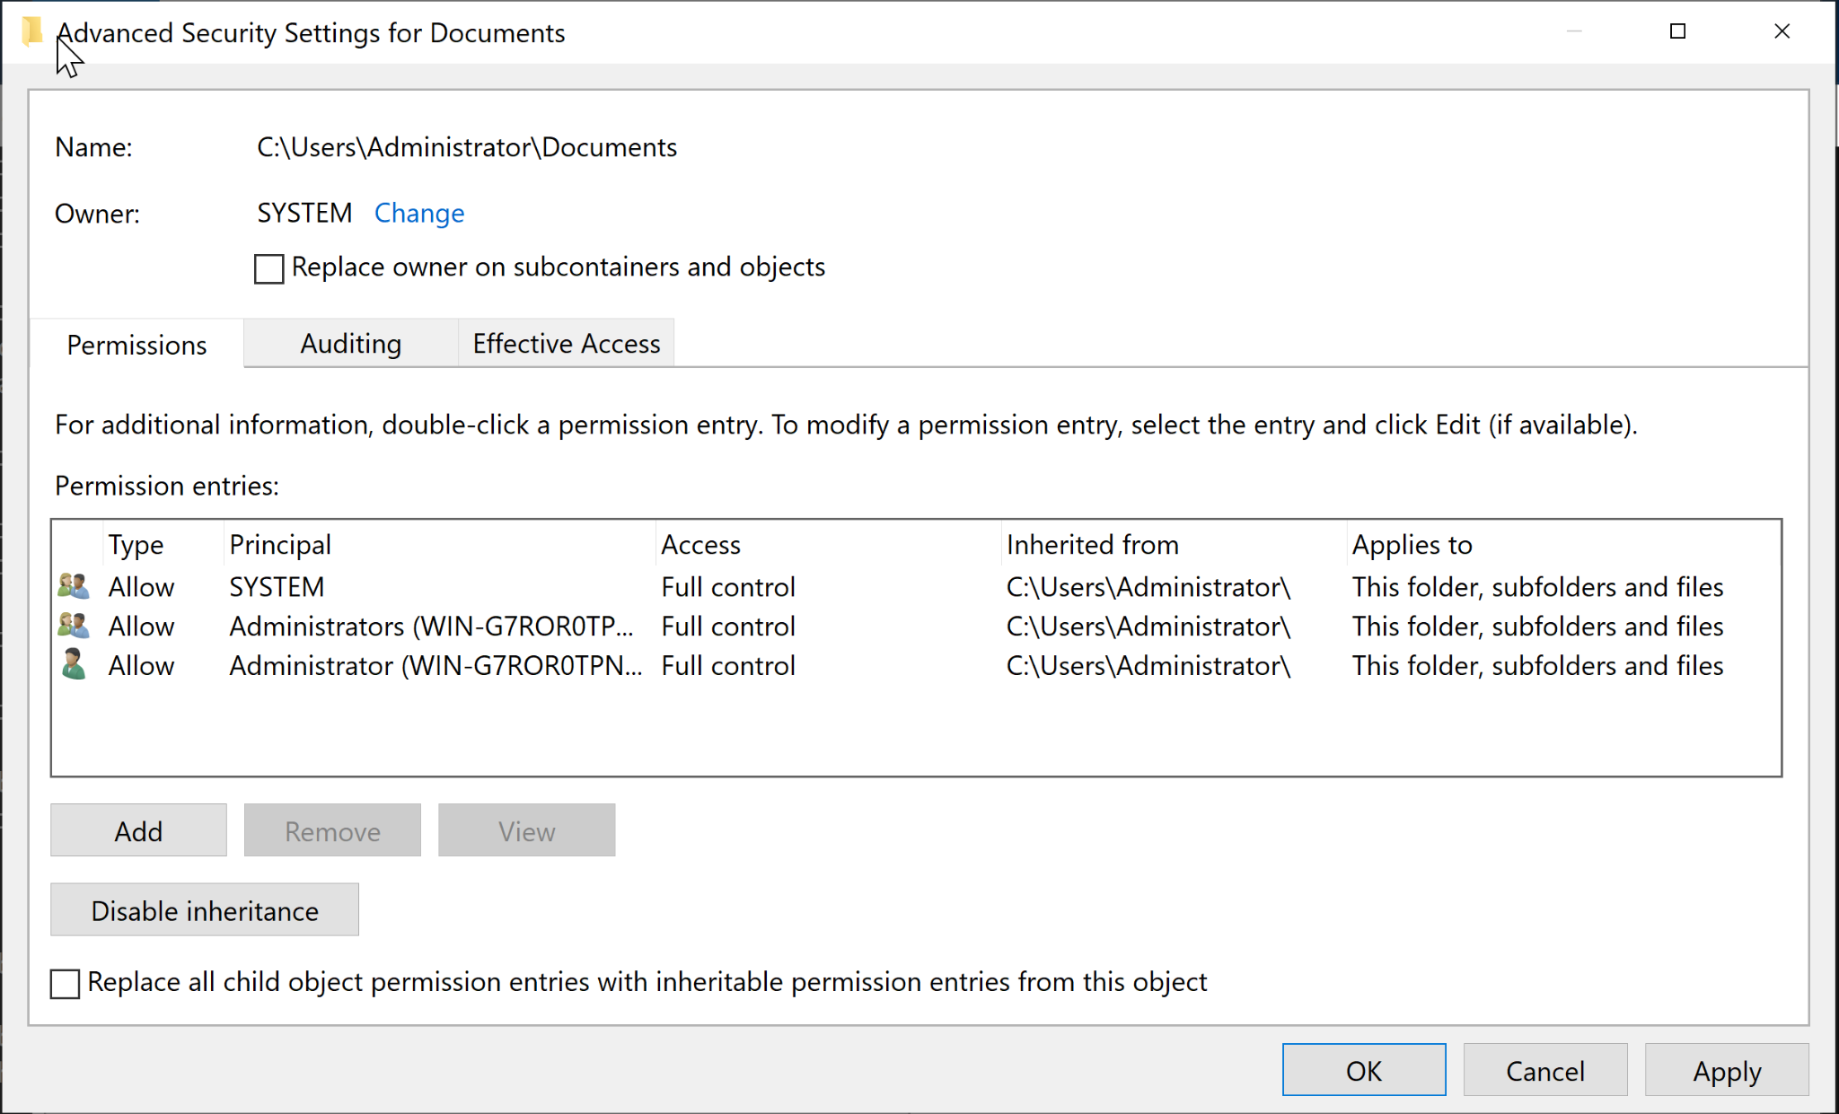
Ownership
Can only edit if you are the owner of a file/folder
Properties → Security → Advanced → Owner: Change
Full Control: user can delete any file or subfolder no matter what the permissions are.

Slide 10
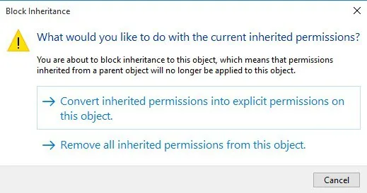
Inheritance
Due to inherited permissions, first “disable inheritance”

Slide 11
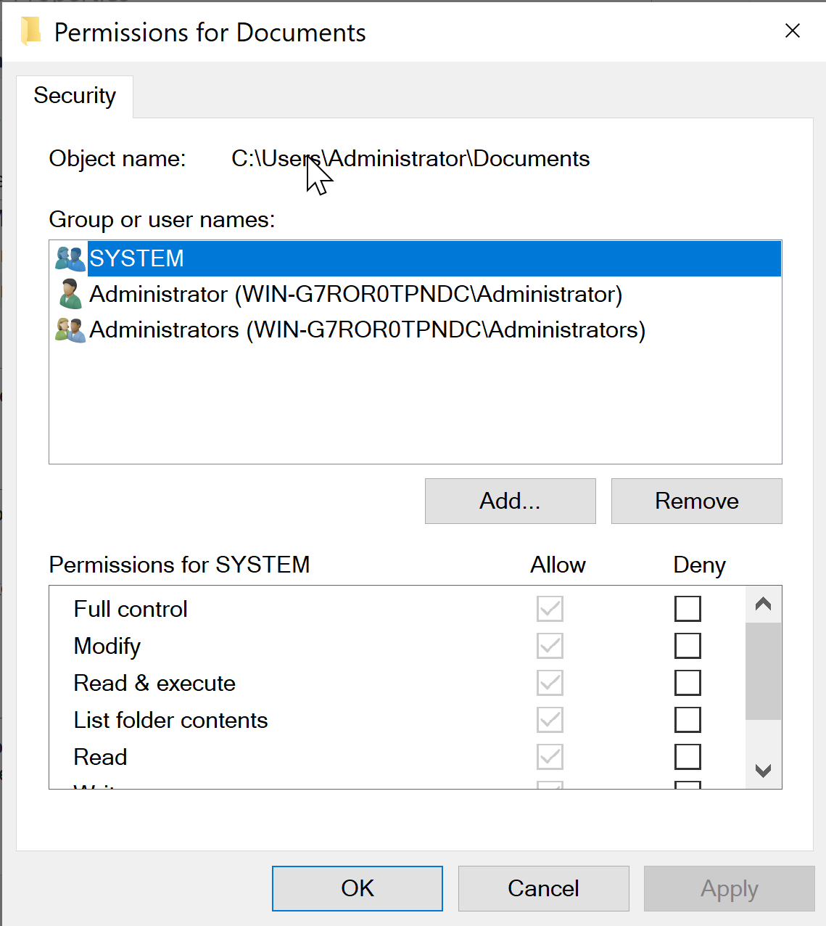
Adding and Removing Permissions

Slide 12
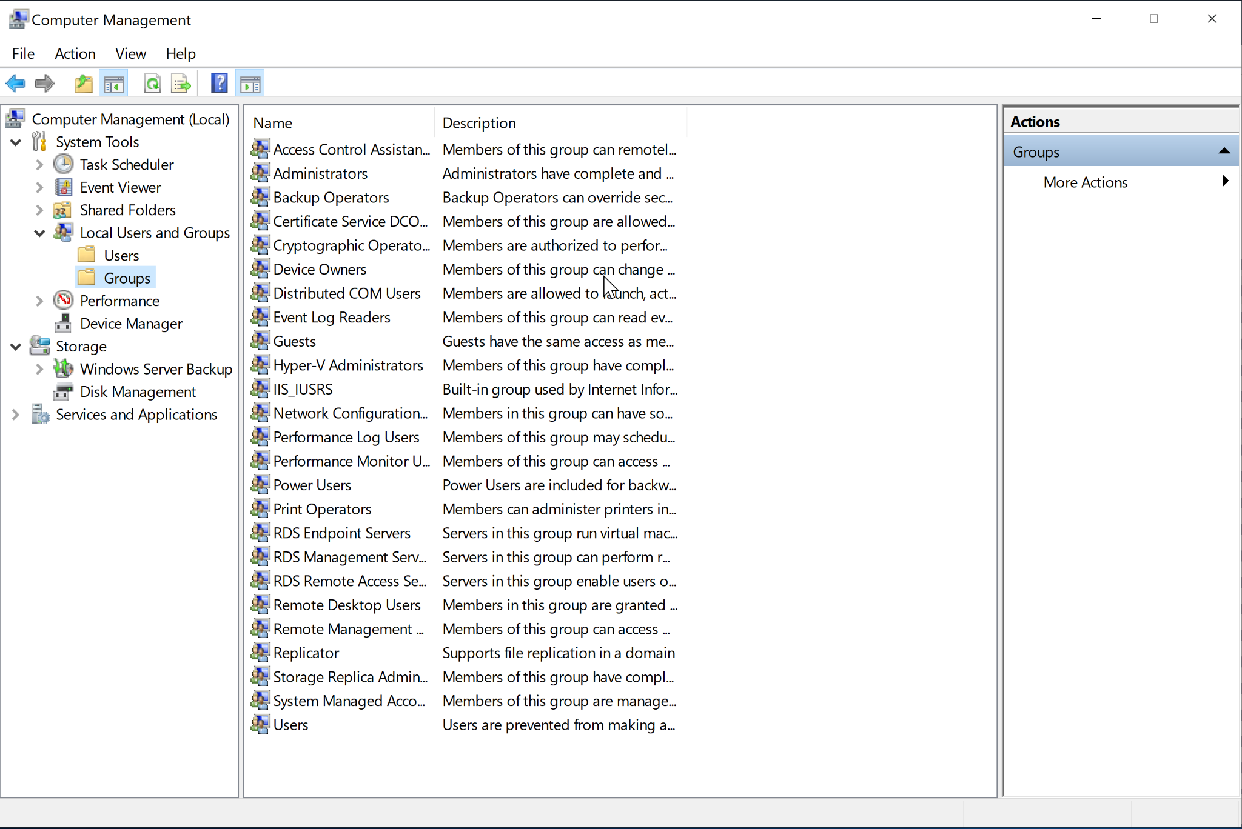
Accessing Groups
Administrative Tools → Computer Management → System Tools → Local Users and Groups → Groups
Windows + R → compmgmt.msc → System Tools → Local Users and Groups → Groups

Slide 13
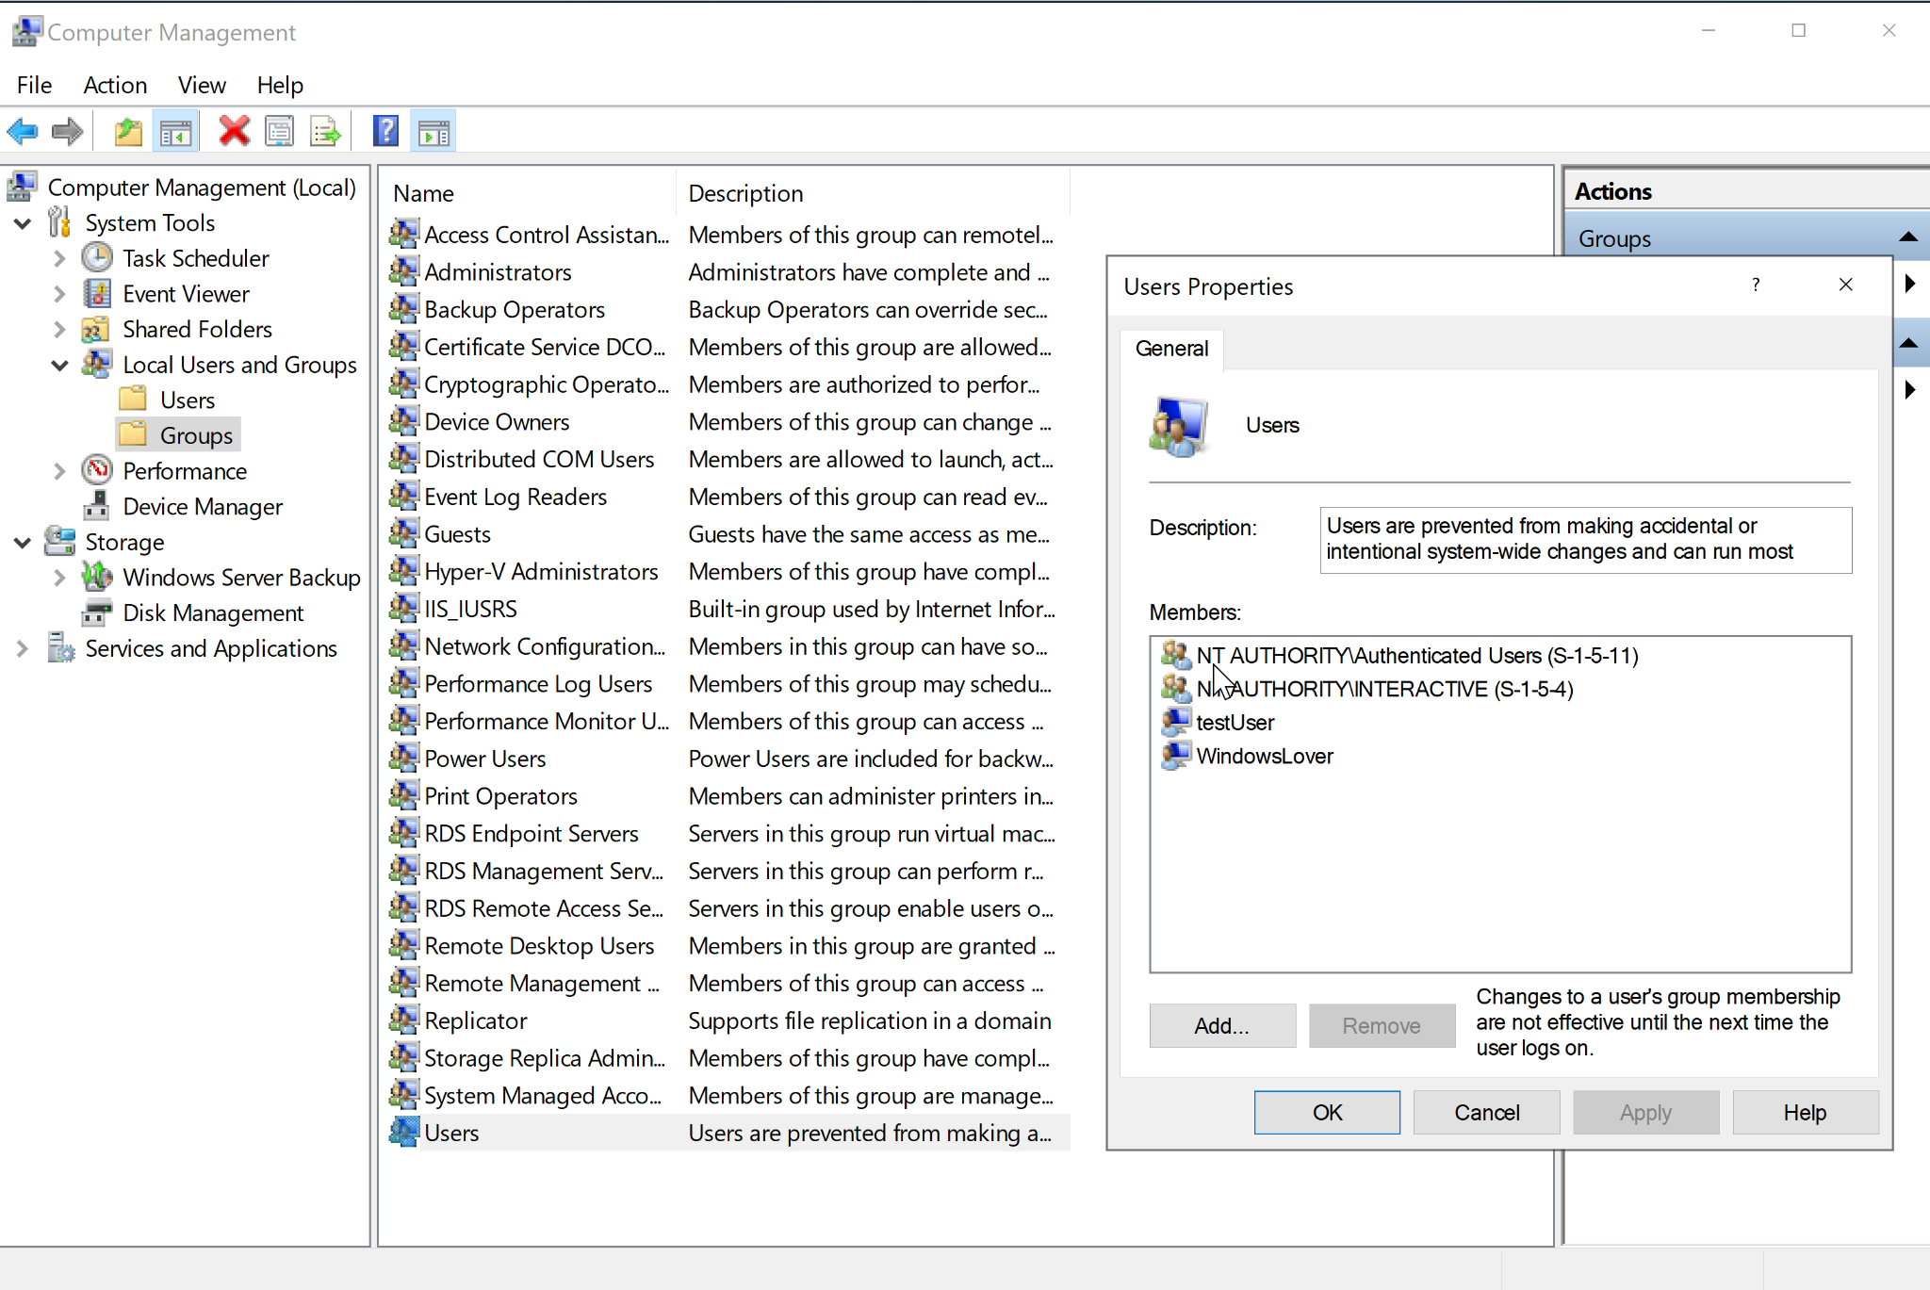
Group Properties
Click on a group → Action → Properties

Slide 14
Questions?

